Slide 1
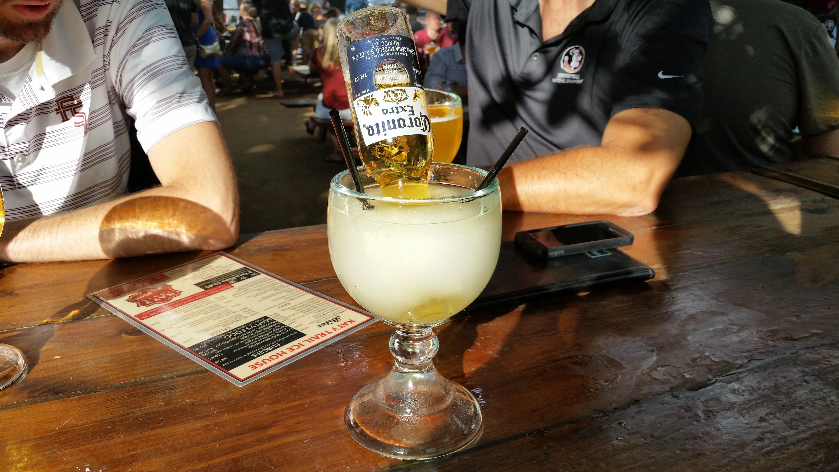
FOOD & BEVERAGE SEMINAR
Presented by
STEVEN BROWN FBII.t.p
SUPREME COMMANDER
of
INN-FORMATION

Slide 2
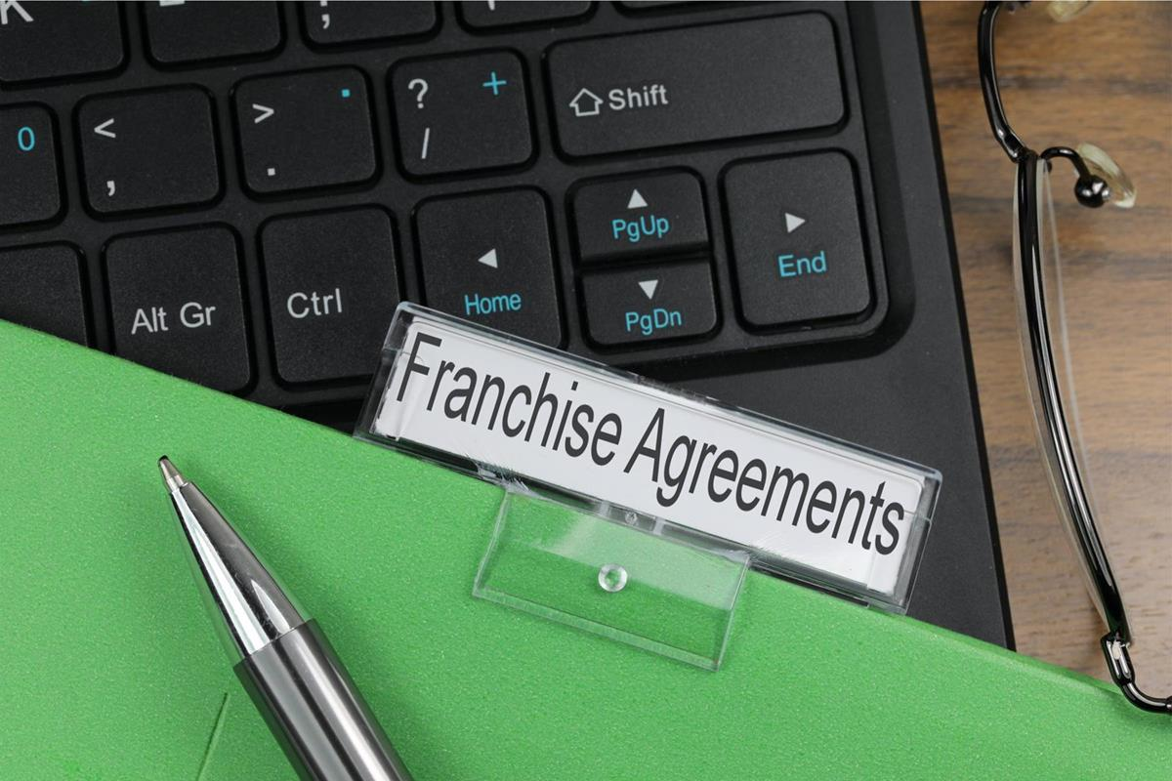
THE RIGHT TRADING MODEL FOR YOU
IN-HOUSE vs FRANCHISED
The single most important decision a club can make regarding its food and beverage operation is whether to operate it in-house or offer it to an external supplier.
Let’s discuss this

Slide 3
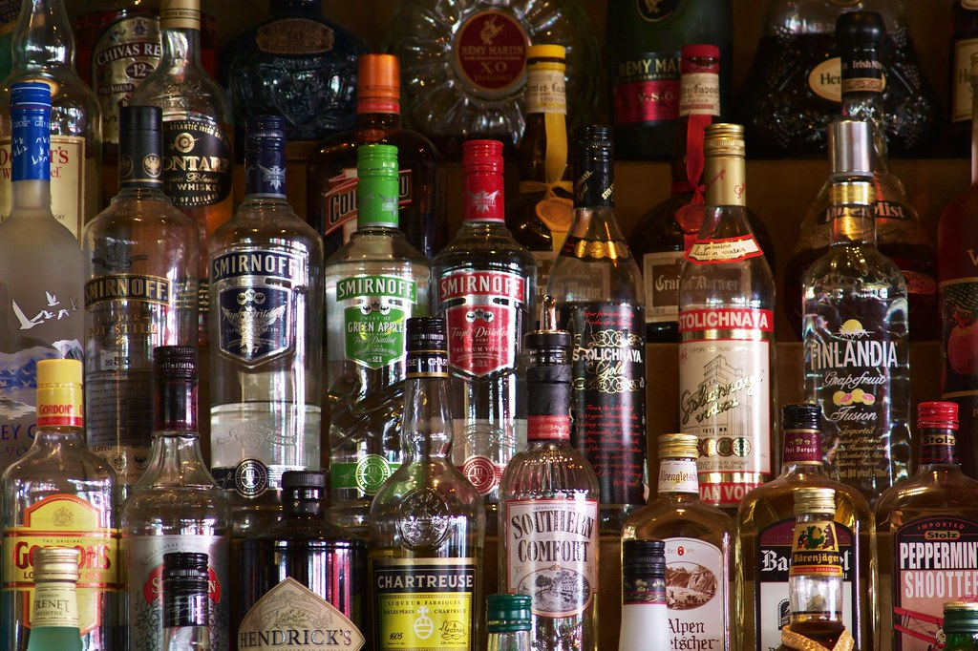
IN-HOUSE
PROS
Total day to day control
Able to shape your own destiny
Able to maximise or control your usage
Able to provide profit to the club
CONS
The need for experienced staff
The need to understand and act correctly on the data
The rising cost of utilities/goods/staffing
The risk of losing money!

Slide 4

FRANCHISED
PROS
Instant experience
Able to focus on other club related issues
Ability to charge a commercial rent
Able still to influence pricing/content
CONS
No water-tight agreement
Losing control
Operating in comfort zones
“Tail wagging the dog”

Slide 5
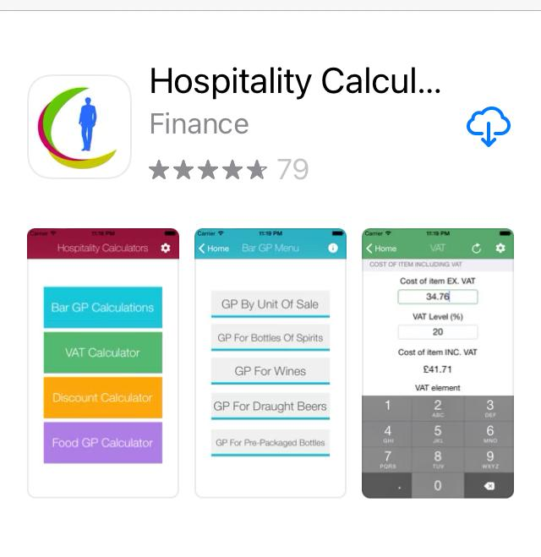

Slide 6

THE PERFECT IN-HOUSE F&B OPERATION
DIRECTION
The 3-year plan
Understanding and responding to members needs
Flexibility but not subject to change every year!
STAFFING
The right trading model
“Round pegs on round holes”
Up to date JD’s
Accountability
Appraisals
The right packages
Training & development
Fairness & respect!

Slide 7

THE PERFECT IN-HOUSE F&B OPERATION
SYSTEMS
Internal stock counts
External stock takes
Utilisation of till data
An A to Z of operational procedures
Realistic budgets
Supporting office back up
COMMITTEES/BOARDS
An understanding of F&B practices
An understanding of F&B norms

Slide 8

THE PERFECT IN-HOUSE F&B OPERATION
COMMUNICATIONS
Keeping staff in the loop
Listening to staff’s ideas
Conducting an F&B survey
Utilising all relevant social media platforms
THE OFFERING/SUPPLIERS
Must be current
Must be presentable/menu well designed
Must be marketed/merchandised
Must obtain the best deal
Must provide a clean and pleasing environment

Slide 9

THE PERFECT IN-HOUSE F&B OPERATION
THE ROLE OF THE GM/SECRETARY
To know as much as your heads of departments
To challenge results
To act on results
To maximise usage/potential (licence type/functions)
To be there when you are not supposed to be
TO CONTROL THE MEMBERS!!!

Slide 10

THE HOT SEAT
FIRE AWAY

Slide 11
Steven Brown FBII. t.p.
is
SUPREME COMMANDER of
INN-FORMATION and can be contacted on
Mobile : 07785 276320
Email : herinn@aol.com
Please follow me on Linkedin
If your Food and Beverage operation is in need of an overhaul then you need INN-FORMATION the golfing industries leading providers of tried and tested solutions
Notes:
Spoken
What's the worst thing that can happen to you
NOTHING ; DEMOTED ; SACKED
Hardly
“The measure of a man is not how many times they fall ITS WHETHER THEY GET BACK UP AGAIN.
In this room today successful people have rubbed shoulders with failures. Let me illustrate
If I had a £100 for every sale I failed to convert I’d be fabulously wealthy - nobody’s that good
I appeared on 7 TV QUIZ SHOWS and only won 2. I’d go on another tomorrow
I joined a company that offered me a directorship, big car and a team of people to work under me., I left within 3 months. Their loss or mine!
LETS HEAR SOME OF YOUR FAILURES or does that make you look weak?

