Slide 1


Membership Sales, Integration and Retention
19th March 2026
Managing Director 59club UK & I

Slide 2
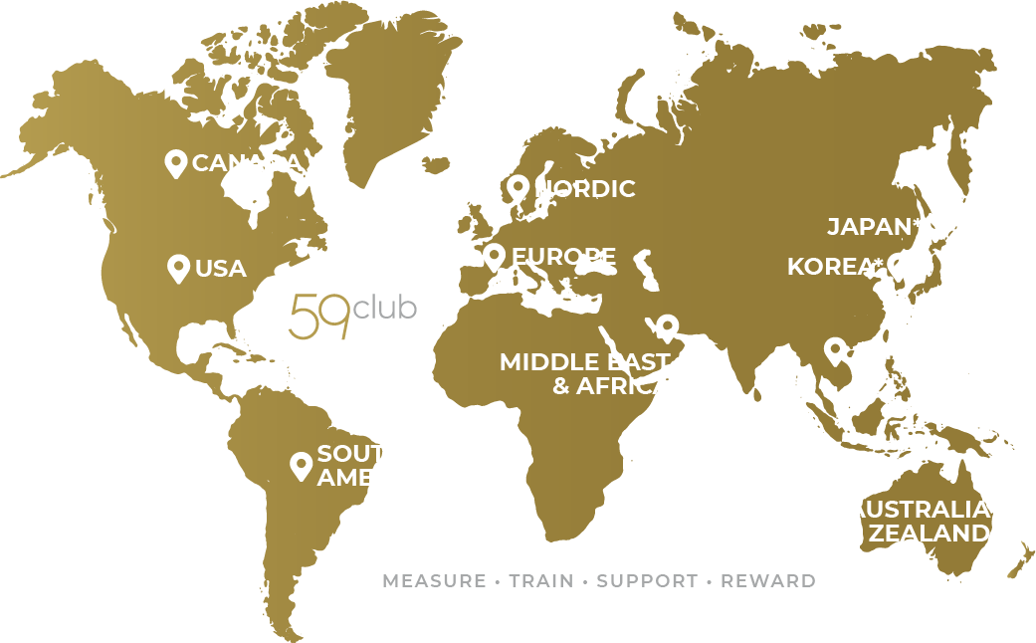
The industry’s leading
Customer Service Analysts & Training Provider
A wealth of ground-breaking performance management solutions and global data support properties to elevate standards and promote profitable business practices.

Slide 3

It’s not 59club – listen to our data
5m Survey data
50,000 Images
5000 MS
10,000 minutes
1000 venues
500 Days
Our data is shouting out ”opportunity”

Slide 4
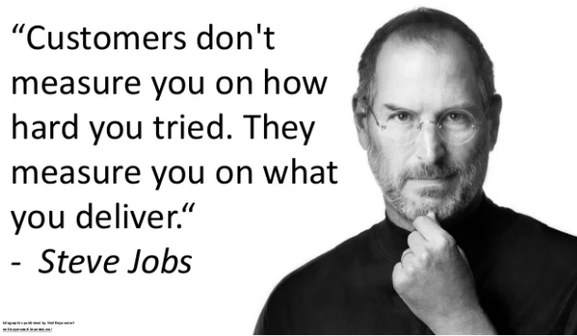

Slide 5
Control the controllables
To some extent a staff member can’t control the number of enquiries... They can however, control the sales process

Slide 6
Do we work in sales?
Do we see ourselves as ‘sales people?’
What is sales?

Slide 7
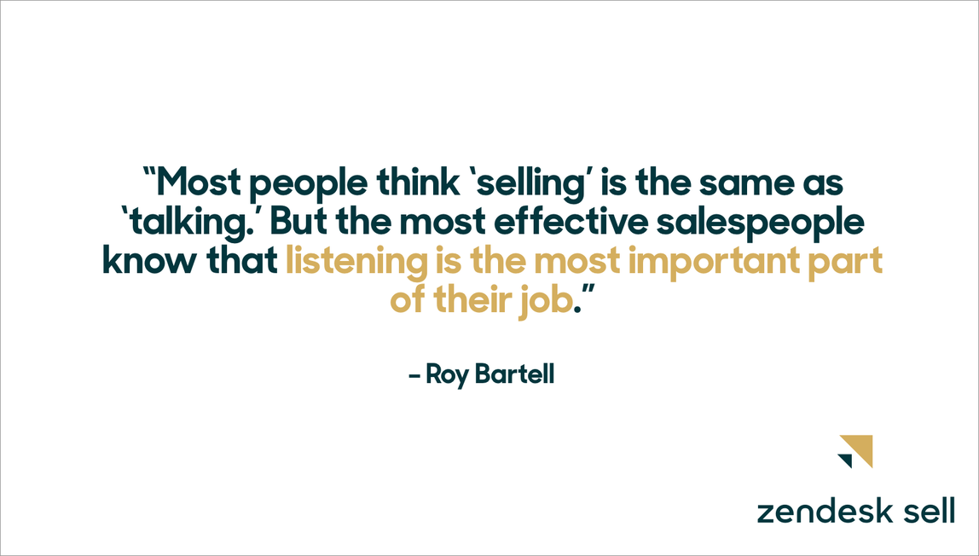

Slide 8
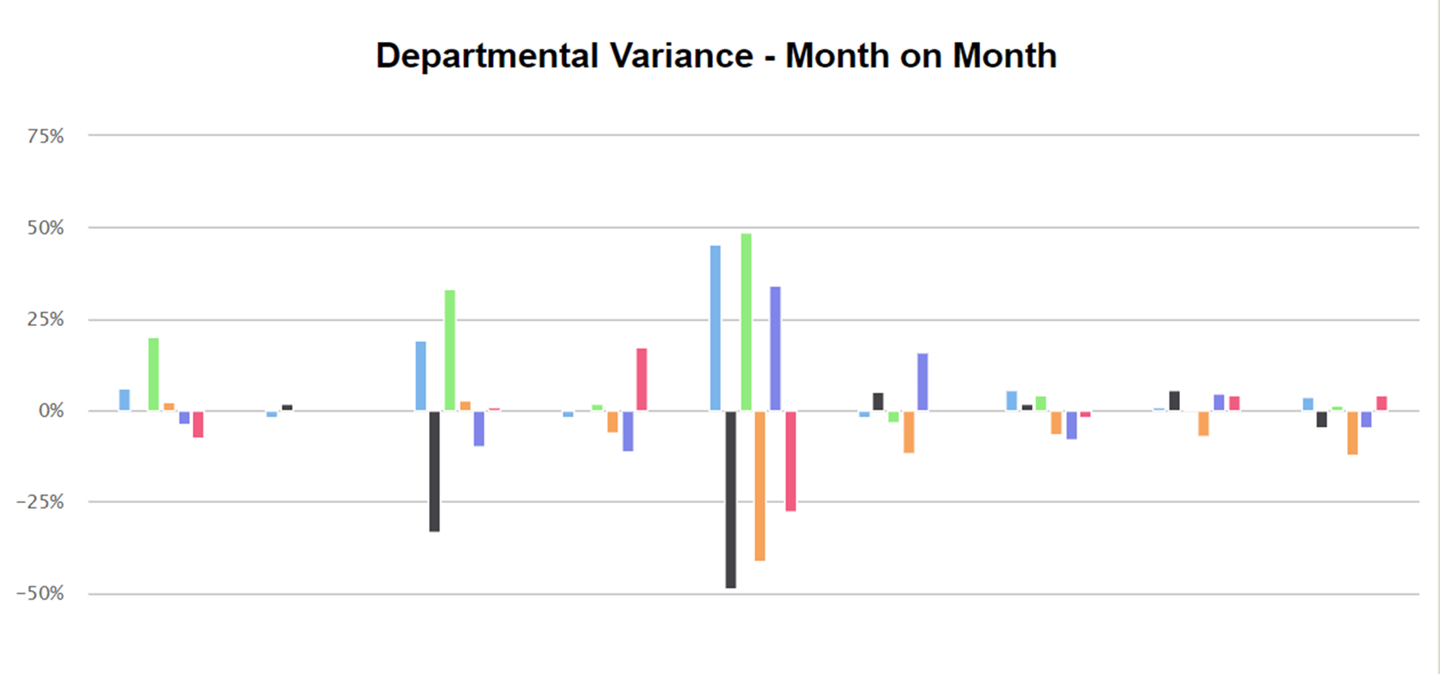
This is then what we see

Slide 9
If we don’t set the standards… our team will!
Think… is our process be-fitting of the type of club that we are/aspiring to be and the membership fees we charge?

Slide 10




Enquiry call
Research
Fact finding
WHO, WHAT, WHERE, WHEN, WHY & HOW
Promotion
Key facilities and USP’s – unique to the individual
Closure
Confirm appointment time, date and location
Follow up
Email and waterproof call/further follow up call if no appointment booked

Slide 11
Difficult to ‘SELL’ to someone if we don’t know the specifics of their enquiry/what ‘itch they are looking to scratch’

Slide 12

Needs analysis – The WHY!
WHO are we selling to? WHO is the membership for? WHO else may be looking to join?
WHAT are they looking for from their membership? WHAT are their main requirements. KEY POINT
WHERE else are they looking/WHERE else have they enquired?
WHEN are they looking for their membership to start? WHEN do they normally play their golf?
WHY are they looking to leave their current club? WHY XYZ Golf Club?
HOW did they hear about you?

Slide 13
Understanding membership requirements
Industry average – 67%
Non 59club average – 40%

Slide 14
Playing habits/when are they looking to play?
Industry average – 39%
Non 59club average – 12%

Slide 15
Without this information, how can we be sure we are promoting the right membership categories???

Slide 16

Be honest
Sometimes membership isn’t going to be right for an individual/group
If they want to play with their friends at 9am every Saturday, is this feasible?
Rather than selling the dream and creating problems down the line, be honest from the outset
Membership has to be the right fit for both parties

Slide 17

Changing rooms/locker facilities
Towels – those looking to play before/after work
Locker procedure
Noticeboards = good insight into what is going on at the club
Ensure all information/literature is presented to a high standard
Social calendar/social events – highlighting a few notable events in the process
Competitions – frequency and how to book
Consider the use of a tablet to showcase club diary information – acts as a prompt too!

Slide 18

Member services - HUGE
Golf Academy/lessons – promote complimentary swing check if applicable
Retail discounts
How to book a tee time/member only slots
Member guest process and greenfee discounts
New member integration – how to meet and interact with other members – Whatsapp groups, pairing up, swindles/roll-ups
Reciprocal/affiliated clubs
Other associated member benefits
Potentially to be discussed within retail setting?

Slide 19

Course & Practice Facilities
Walk/jump on a buggy
Showcase signature holes/areas of recent investment/areas with best views – desire here is to inspire and excite
Think about the ability/handicap of prospect – back tees/forced carries may put some people off
Talk about history and heritage
Trial round may be more applicable for some clubs – should still involve a sit down and show round!
Showcase range and other practice facilities – particularly important for those that are looking to improve
Range opening hours and discounts for members

Slide 20

F&B Facilities
Big part of why people join a golf club – make sure that we shout about it!
We want golfers to utilise all of our facilities – less car park golfers
Showcase menu and discuss membership discount – have a menu on your table as a prompt?
Can guests/family members use the facilities?
Food availability and clubhouse opening and closing times
Themed evenings/upcoming social events/notable diary dates

Slide 21
What does your new member welcome pack say about your club?
Is it commensurate with the membership rates you are charging?

Slide 22
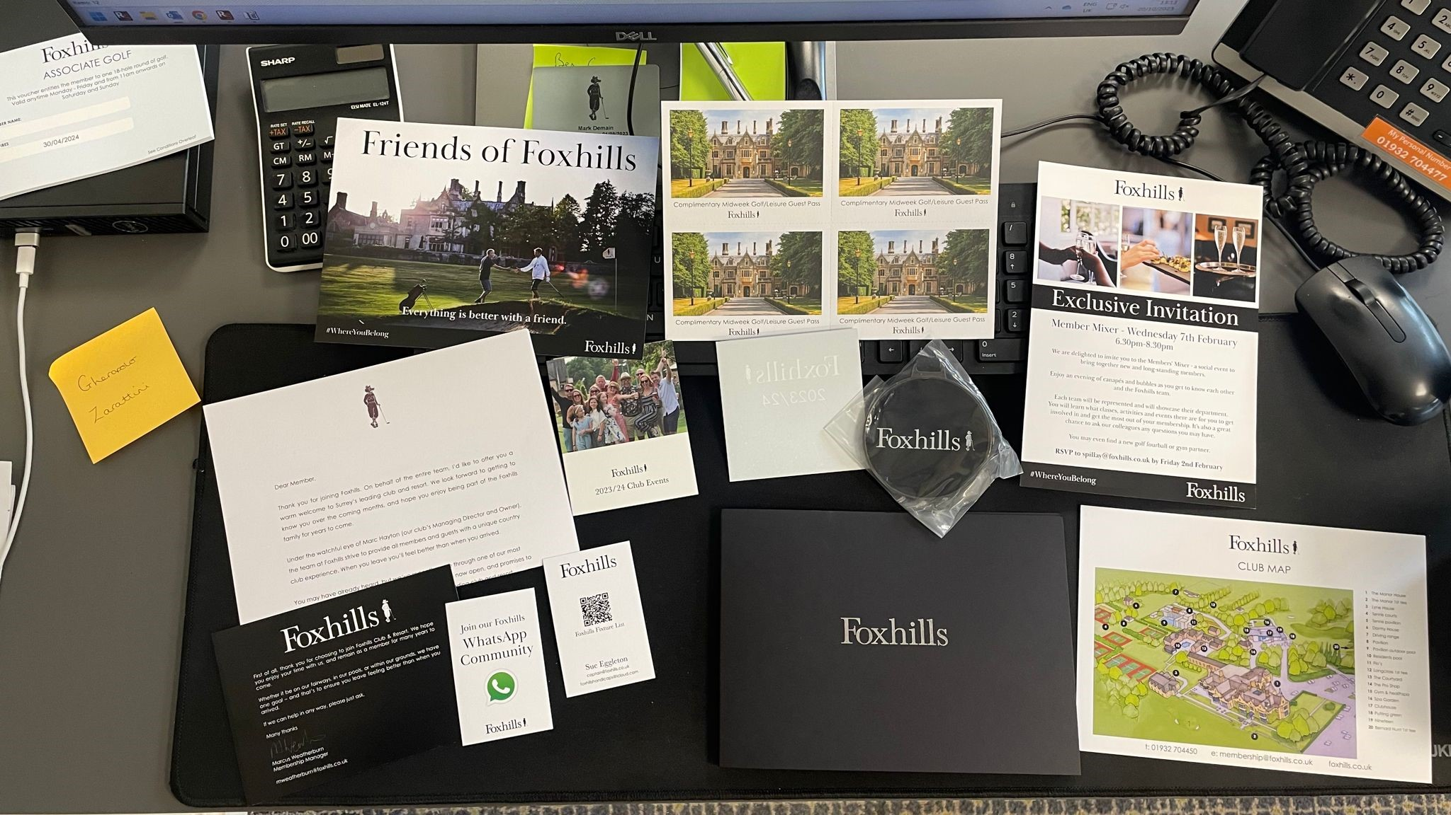

Slide 23
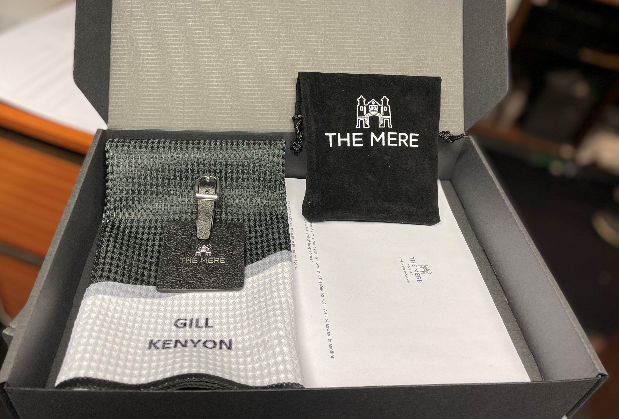

Slide 24
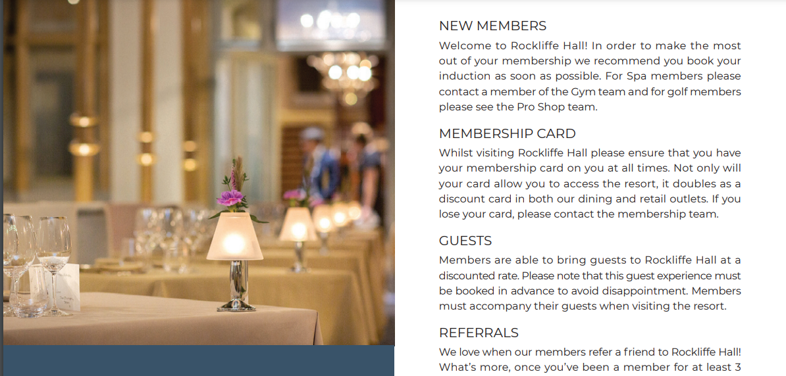
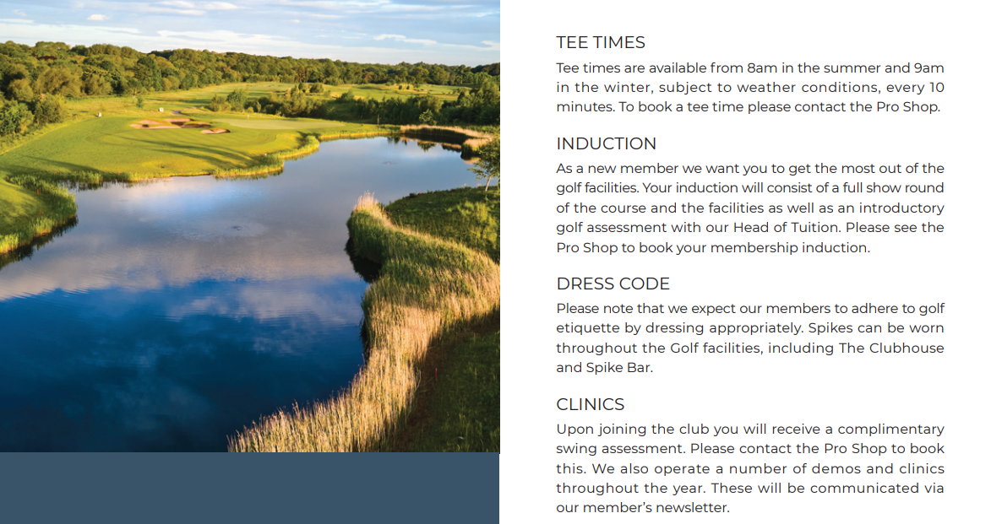

Slide 25
When a member does join your club, make sure that you follow through on your promises!
Very easy to sell the dream!

Slide 26

Joining a golf club
Exciting yet overwhelming and intimidating for some
Think first day at school
Membership = big investment, both from a time and financial perspective
Expectation to be welcomed with open arms – individual not a number
Although clubs may have a new member journey on paper, is this being delivered time after time?
Is this being measured/tracked?
Notes:
Focus here on the fact that the very best golf clubs treat their new members as individuals rather than a number. Link here to my previous experience when joining David Lloyd – large financial outlay, especially given how often I use the facilities, yet the new member journey was pretty well non-existent.
Our experience is that although a lot of clubs claim to have a new member roadmap and journey, in reality, they are not confident that this is being delivered

Slide 27

Never assume
Some new members will have just moved to the area
For some, could be their first golf club membership
Need to ascertain reasons for joining from the outset – NEEDS ANALYSIS
Rest of the new member journey, touchpoints and strategies can then be tailored accordingly

Slide 28

New member integration
Without a structured programme, you risk leaving first impressions to chance
When outlining your roadmap, need to think like a new member – speak to new(ish) members along the way. What worked well, what needs to change?
Involve all team members – more likely to be followed through
Think… can this be replicated day in and day out? Sometimes less is more
If you have a plan, when was this last reviewed?
Notes:
If you don’t have a well developed and well-structured new member orientation programme in place, you risk leaving their first impression to chance.
To create and establish a meaningful new member integration programme, you and your team need to think like a new member, asking yourself the question of “If I had just joined the club, what would I expect? What information would I expect to be given? Who would I expect to be introduced to along the way?
When devising a new member integration programme, need to ensure that all touchpoints can be replicated on a consistent basis. Counterproductive rolling out the red carpet for some yet missing others along the way. Sometimes less is more and doing the right things day in and day out will help to make the member feel at home and part of something from the outset, helping you to stay well ahead of your competition also.

Slide 29

Practical example
On joining
Sales team attempt to book tee time
Ideally with another member/club ambassador – same with trials
Within 48 hours
Create online booking credentials and communicate
Issue new member welcome pack – bag tag and other branded items
Add to member distribution list
Notes:
Sales team to book in first experience, ideally on the day of joining, whether that be a golf tee time, gym induction, tennis session etc…
Please note that this example does not include a tour of the facilities/formalized induction meeting, as this would have been carried out by the membership sales advisor prior to the new member joining

Slide 30
New member roadmap
Within 7 days
Welcome call from Head of Department
Transfer handicap
Invite to Club for coffee chat
10 day check in
Have they used the club? Have the experiences been positive?
Any questions that have arisen?
Communicate upcoming social events and book space where possible

Slide 31
New member roadmap
3-month call
Sales team check in to ensure integration
Referral opportunity – Guests? How did they find the Club?
3-9 months
Personal and relevant invitations to social events
Track usage and attempt to address if low

Slide 32
New member roadmap
11 month renewal call
Gain feedback and attempt to address any issues
Recognise anniversary of membership
Referral recognition and opportunity to re-promote benefits

Slide 33
What gets measured gets done!
Trackers and a robust are a must here to hold those responsible accountable

Slide 34

New member events
How many of you organise a new member event?
What do these look like?
Golf or non-golf?
Who attends?
How frequently?
Success stories

Slide 35

Time = obvious barrier
Think however, about the lifetime value of that member
May be worth spending 30 minutes or so of your time at the outset

Slide 36

Average tenure as a member
Industry data indicates 7-year average
£1.5k in membership subs per year
£500 joining fee in year 1
£750 per year (F&B, Retail, tuition) per year
=£16,250 total over 7 years
We therefore need to get this right!
Improving retention rate by 1% can have a dramatic impact financially
Notes:
Is this consistent with what you are seeing within your clubs?
Club with 500 members, improving retention figures by only 1% = £7,500 based on £1,500 membership subscription

Slide 37

Numbers don’t lie
Review the following key stats:
How much have they played?
Have they entered any competitions?
Have they engaged/integrated with the relevant section(s)
Are they making use of the other facilities?
Are they interacting with club communications?
If usage is low, may indicate that something isn’t right
Take corrective action if needed
If you don’t have a tee sheet, what do you do?

Slide 38

Questionnaire
Personal and relevant information about the new member
Helps to build up bio
Staff can use this information when chatting to members, helping to personalise future interactions
Helps to paint a more complete picture about that member
Celtic Manor example – days going to play, car they drive, who they already know etc…

Slide 39

Health and Fitness example
Chain of 21 hotels, joining 2k + members annually
New member journey defined and agreed by Club Managers – not imposed by head office
Formalised, written down and cascaded to the team
Series of 3 surveys over first 90 days, indicated that only 17% of members experienced the journey as defined
Wouldn’t of known this without any form of measurement

Slide 40

Only 21% of Golf Clubs conduct a new member survey
Notes:
For me, staggeringly low percentage. Without such information, how do we continually improve.
In our day to day, we see a lot of people build a survey with our help, yet this is never sent out. Also see people start to send out surveys, then after time this starts to drop off also

Slide 41

Use of surveys
Series of automated surveys over first 90 days of membership – some clubs opt for singular survey
90 days = where habits are formed
Different questions asked at each stage
First survey – more practical, have you had XYZ
Follow on surveys – how do you feel, with practical elements thrown in
Time frame = whatever works for the club

Slide 42

Feedback is vital
Helps to identify new members who are struggling and need assistance
Helps to evaluate the current new member journey and where tweaks need to be made
Is the new member journey achievable?
Highlights training needs and requirements amongst the team

Slide 43
Retention should not start at renewal time. Continuous and ongoing process

Slide 44

Retention is the name of the game
Some clubs are guilty of focusing too much on attracting new members
Costs far less to retain
EG Research – New member to retained member takes 3 years
Create a habit by providing the best experience possible – retention should then look after itself

Slide 45

Communication is key
Club newsletter/update/bulletin
How often is this being sent out?
Do we review engagement rates?
Only 30% of active members play competitive golf – newsletters tend to be competition results heavy. What are we doing to keep the other 70% engaged?
Use this platform to build your community

Slide 46


Other platforms being used
Podcasts
Video – F&B Manager, Head Chef, Professional staff
Vlog – Course Manager
Social Media
Club noticeboard – never underestimate the power! How do these look?

Slide 47

2-way communication
Listen and seek feedback from your members
Surveys – get their input & understand their preferences
Annual satisfaction, post event, post competition etc…
Remember, Members = customers
If you don’t know what your customers are saying, how can you improve

Slide 48

32% of members say their Clubs never ask for feedback

Slide 49

Waste of time!!!
Must do something with the feedback
Reluctance to participate in future exercises
You Said, We Did
Member forums
Member Q+A’s

Slide 50
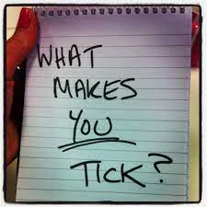
Understand your audience
Understand your members and their preferences
What are they looking for?
Organise events and competitions to try to satisfy their needs and create club feel/vibe
Seek feedback – WWW/EBI, what else are they looking for?
Review

Slide 51

Why do people leave?
To make meaningful and impactful changes, need to understand why members are leaving your facility
Once you understand some of the defining factors, Club can take steps to address
Some will be out of your control, many won’t
Member exit survey/interview

Slide 52

Example questions
Did your golf membership experience represent value for money?
During your time at the Club, did the staff make you feel welcome?
Main reason(s) you have decided not to continue with your membership?
Which areas do you feel the Club needs to improve on the most?

Slide 53
Interestingly however… only 37% of Clubs carry out leaver surveys

Slide 54


Creating the knowledge to move forward effectively
“Over 100 million people around the world will experience golf this year.
People will join golf clubs when golf clubs are selling the product that people want to buy. We have to keep changing and we have to keep being modern and relevant”
Martin Slumbers - Former CEO R&A

Slide 55
Reputation is Everything
Four out of ten consumers will recommend others not frequent a business if they have had poor customer service from them.
After a bad customer service experience, 39% of customers will avoid a company for two years.
91% of customers who are unhappy with a brand will just leave without complaining.
The average customer tells 15 people when they’ve had a poor customer service experience.

Slide 56
Thank you!
Any questions?

